Slide 1
Arithmetic Operation
Kartika Purwandari, S.Kom., M.Sc.
kartika.purwandari@binus.ac.id

Slide 2
Outlines
Operator and Operand Introduction
Assignment Operators
Arithmetic Operators
Relational Operators

Slide 3
Operator
Now we have knowledge to store values into variables, get input from user and show the values stored in variable
What If we want to use manipulate the variables like addition?
We can use mechanism called “Operator”
An operator is a symbol used to perform operations between operands like +, -, *, /, and etc.

Slide 4
Operand
An operand specifies an entity on which an operation is to be performed.
An operand can be a variable name.
Example:
  for example a=b+c+d+2;
    in this statement, a, b, c, d, 2 are the operands,
    and =,+ are the operators.

Slide 5
Assignment Operators
A binary operator
Used in assigning value to an operand
Syntax:
    Operand1 = Operand2;
Left hand side operand (Operand1) should have (L-Value) such as variable
Right hand side operand (Operand2) can be constant, another variable, expression or function

Slide 6
Assignment Operators (cont..)
Example:
    x = 2; // constant
    x = y; // other variable
    x = 2 * y; // expression
    x = sin (y); // function
Type of the result will follow the left hand side operand
    int x = 7/2; /*x value is 3 not 3.5*/
    float y = 3; /*y value is 3.000 */

Slide 7
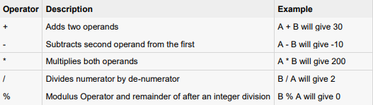
Arithmetic Operators
An operator is a symbol that tells the compiler to perform specific mathematical or logical manipulations. C language is rich in built-in operators and provides the following types of operators:

Slide 8
Arithmetic Operators (cont..)
Modulo
  Symbol : %
  Binary operator
  To find reminder of a division
  N % 2, can be used to find an odd or even number
    N % 2 = 0 → N is even
    N % 2 = 1 → N is odd
Increment and Decrement
  Symbol : ++(increment), --(decrement)
  Unary operator
  Increase (++) and decrease (--) the value of a variable by 1.
  Its position can be in the front (pre) or after (post) a variable.

Slide 9
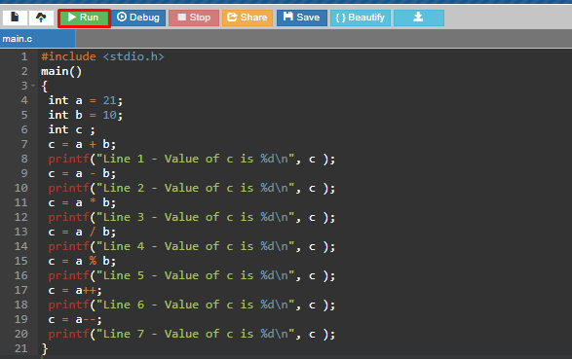
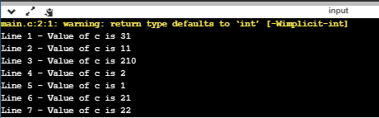
Examples

Slide 10
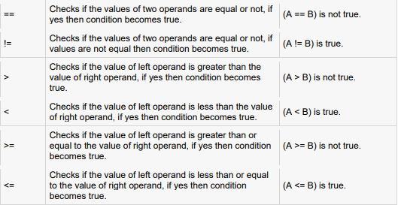
Relational Operators

Slide 11
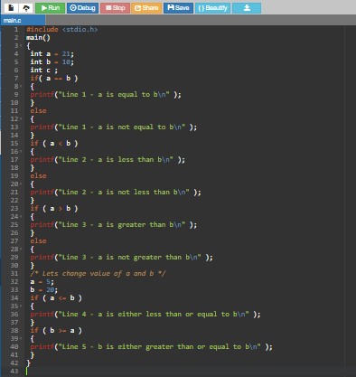
Example

Slide 12
References
C Operators (w3schools.com)
www.geeksforgeeks.org/operators-c-c/

